Slide 1
Color spaces and JPEG

Slide 2
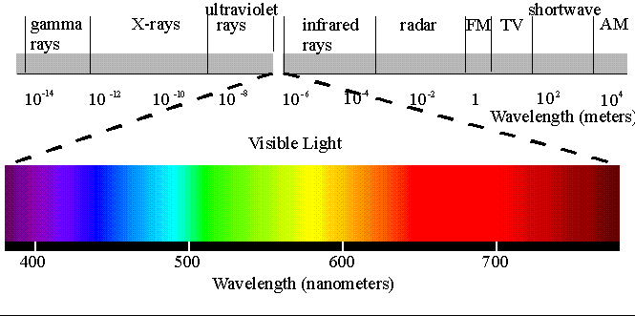
Colors
physically, color is electro-magnetic radiation (i.e. light with various wave length, between 390nm-750nm) percieved by the human eye
a color is actually made from a combination o light radiations with different wave lengths
electro-magnetic radiation spectrum:

Slide 3
Color spaces
color space = a mathematical model used to describe colors as tuples of numbers
RGB – Red, Green, Blue
CMYK – Cyan, Magenta, Yellow, Key Black
YUV(YCbCr) – Luminance, Chrominance blue, Chrominance red
HSV (HSB) – Hue, Saturation, Value
HSL – Hue, Saturation, Lightness

Slide 4
RGB
the color is specified as an additive combination of three primary colors: Red, Green, Blue
in addition, a white point must be specified for this color model
is mostly used in computer graphics
has a variation, RGBA, with alpha channel for transparency
black is 0 0 0
white is 255 255 255

Slide 5
CMYK
the color is obtained by substracting from a white substrate the color components cyan, magenta, yellow and black
mainly used in paper printing

Slide 6
YUV
a color is composed from 3 components: Y-luminance (brightness of the pixel), U-blue chrominance, V-red chrominance
YPbPr is a scaled version of YUV used in analog television standards and YCbCr is a scaled version of YUV used in digital films and video and image compression standards like MPEG and JPEG

Slide 7
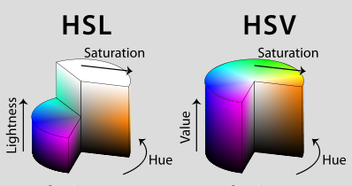
HSL and HSV
a color is described by 3 components: Hue (nuanta de culoare), Saturation(saturatia culorii) and lightness/brightness
HSV is also known as HSB (hue, saturation, brightness)
is mainly used by artists
HSL and HSV are cylindrical-coordinate representation of color points in the RGB (cartezian-coordinate) model

Slide 8
Color space conversions
RGB to YCbCr
  Y = 0.299*R + 0.587*G + 0.114*B
  Cb = 128 – 0.1687*R – 0.3312*G + 0.5*B
  Cr = 128 + 0.5*R – 0.4186*G – 0.0813*B
RGB (1-255) to CMY (0-1)
  C = 1 – (R / 255)
  M = 1 – (G / 255)
  Y = 1 – (B / 255)

Slide 9
JPEG - Joint Photographic Experts Group

Slide 10
JPEG
is the name of an digital image compression standard created by ISO/IEC Joint Technical Committee 1, Subcommittee 29, Working Group 1 (ISO/IEC JTC 1/SC 29/WG 1); the standard is also recommended by ITU-T
stands from Joint Photographic Experts Group, the name of the committee that created the standard
is a lossy compression standard (different than lossless image compression like TIFF, GIF, PNG, BMP etc.)
JPEG has 2 operation modes:
  baseline – lossy compression with a quality/compression factor from 1 to 100
  progressive – an image is compressed in multiple phases of progressively higher detail

Slide 11
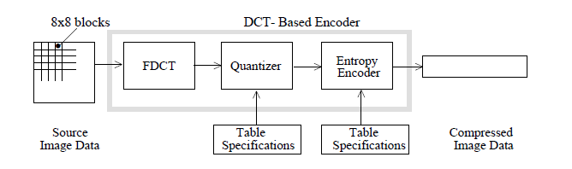
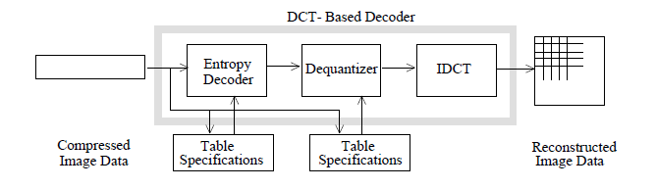
JPEG baseline process
JPEG operates on 8x8 or 16x16 pixels macroblocks which are compressed independently
the JPEG encoder/decoder structure:

Slide 12
JPEG baseline compression algorithm
1. Color space conversion (to YUV) and possibly padding
2. Downsampling & block splitting
3. Discrete Cosine Transform (DCT)
4. Quantization
5. Entropy encoding
5.1 Zig-zag order of the coefficients, then Run-length
encoding
5.2 Huffman encoding

Slide 13
1. Color space conversion (to YUV) and possibly padding
the colors of pixels are converted to YUV color space
  Y = 0.299*R + 0.587*G + 0.114*B
  U = 128 – 0.1687*R – 0.3312*G + 0.5*B
  V = 128 + 0.5*R – 0.4186*G – 0.0813*B
then the image is pixel padded at right and bottom so that width and height are multiple of 8 (16) bits

Slide 14
2. Downsampling & block splitting
YUV image is split in 8x8 or 16x16 blocks and downsampled:
  4:4:4
  4:2:2
  4:0:0

Slide 15
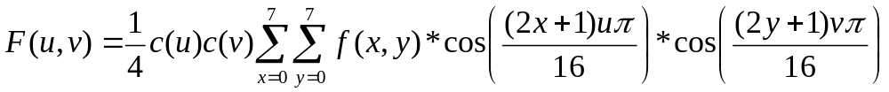
3. Discrete Cosine Transform (DCT)
the color values (YUV) are converted from the spatial (time) domain into frequency domain using the DCT formula bellow (similar to DFT – Discrete Fourier Transform):
f(x,y) – pixel color (x=0..7, y=0..7)
c(u)=c(v)=1/sqrt(2) for u,v=0
c(u)=c(v)=1 otherwise
F(0,0) - DC coefficient
F(u,v) – AC coefficients (u,v different than 0)

Slide 16
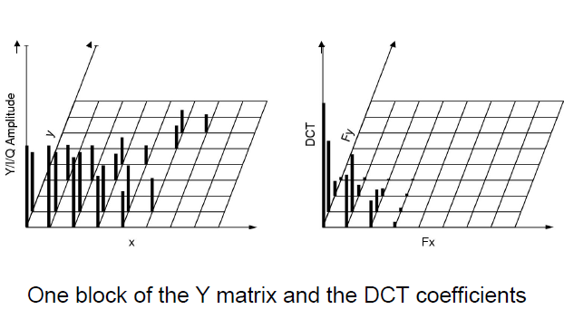
3. Discrete Cosine Transform (2)

Slide 17
3. Discrete Cosine Transform (3)
Each 8x8 block of source image samples is effectively a 64-point discrete signal which is a function of the two spatial dimensions x and y. The DCT takes such a signal as its input and decomposes it into 64 orthogonal basis signals. Each contains one of the 64 unique two-dimensional (2D) “spatial frequencies’’ which comprise the input signal’s “spectrum.” The output of the DCT is the set of 64 basis-signal amplitudes or “DCT coefficients” whose values are uniquely determined by the particular 64-point input signal
the DCT tends to concentrate the strength (i.e. average intensity/color) of the block in the DC coefficient (the coef. of zero frequency in both dimensions;
the other coefficients contain variations of the average intensity/color and are called AC coefficients

Slide 18
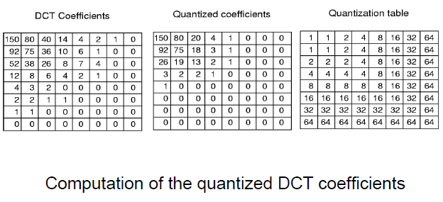
4. Quantization
each DCT coefficient obtained at step 3 is divided by a quantization value

Slide 19
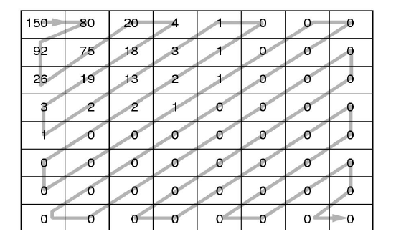
5. Entropy encoding
entropy enoding = zig-zag order + run-length encoding + Huffman encoding
Zig-zag order:
The preceeding block is encoded as: 150, 80, 92, 26, 75, 20, 4, 18, 19, 3, 1, 2, 13, 3, 1, 0, 1, 2, 2, 0, 0, 0, 0, 0, 1, 1, 0, 0, 0, 0, 0, 0, 0, 0, 0, 0, 0, 0, 0, 0, 0, 0, 0, 0, 0, 0, 0, 0, 0, 0, 0, 0, 0, 0, 0, 0, 0, 0, 0, 0, 0, 0, 0, 0

Slide 20
Entropy encoding of the DC coef.
the DC coefficient of a block is encoded separately than the AC coefficients of that block
the difference between the current DC and the DC from the previous block is encoded as 2 symbols:
(SIZE) (AMPLITUDE)
SIZE = is the number of bits used to encode AMPLITUDE; is encoded as a variable-length code(VLC) from a Huffman table
AMPLITUDE = is the amplitude on the coefficient difference; is encoded as a variable-length integer (VLI) code whose length in bits is given in the table from the next slide

Slide 21
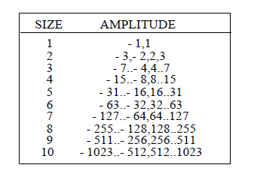
The table for the VLI code of AMPLITUDE

Slide 22
Entropy encoding of the AC coefs.
AC coefficients are parsed in a zig-zag order and then run-length encoded and then Huffman encoded
in general, the sequence of characters:
a b c c c c d d d e f g g g g g g h h is run-length encoded into the sequence:
a b 4c 3d e f 6g 2h
in JPEG, each non-zero AC coef. is encoded in combination with the runlength (consecutive number) of zero-valued AC coefs. into a pair of symbols:
(RUNLENGTH, SIZE) (AMPLITUDE)
where SIZE and AMPLITUDE are like the ones used for the DC coef. and RUNLENGTH – the number of consecutive zero-valued AC coefs. in zig-zag order preceeding the nonzero AC coef. being represented
symbol 1 is encoded as a variable-length code(VLC) from a Huffman table
symbol 2 is encoded as a variable-length integer (VLI) code whose length in bits is given in the previous table

Slide 23
Entropy encoding of the previous quantization block example
the zig-zag order of coefficients:
150, 80, 92, 26, 75, 20, 4, 18, 19, 3, 1, 2, 13, 3, 1, 0, 1, 2, 2, 0, 0, 0, 0, 0, 1, 1, 0, 0, 0, 0, 0, 0, 0, 0, 0, 0, 0, 0, 0, 0, 0, 0, 0, 0, 0, 0, 0, 0, 0, 0, 0, 0, 0, 0, 0, 0, 0, 0, 0, 0, 0, 0, 0, 0
is run-length encoded (assume DC in the previous block is 0) into:
(8)(150), (0,7)(80), (0,7)(92), (0,5)(26), (0,7)(75), (0,5)(20), (0,3)(4), (0,5)(18), (0,5)(19), (0,2)(3), (0,1)(1), (0,2)(2), (0,4)(13), (0,2)(3), (0,1)(1), (1,1)(1), (0,2)(2), (0,2)(2), (5,1)(1), (0,1)(1), (0,0)
(0,0) – is EOB (End Of Block)
the above sequence is Huffman (VLC and VLI) encoded into: (111110)(10010110), (11111000)(1010000), (11111000)(1011100), (11010)(11010), (11111000)(1001011), (11010)(10100), (100)(100), (11010)(10010), (11010)(10011), (01)(11), (00)(1), (01)(10), (1011)(1101), (01)(11), (00)(1), (1100)(1), (01)(10), (01)(10), (1111010)(1), (00)(1), (1010)

Slide 24
JFIF File Format (.jpg) – see class dmms.jpeg.JPGInfo.java
The format of a JPEG/JFIF file is:
Header:
  It occupies two bytes.
  0xff, 0xd8 (SOI : Start Of Image ) (these two identify a JPEG/JFIF file).
Segments or markers:
  Following the SOI marker, there can be any number of segments or markers such as:
  APP0..APP15, SOF0..SOF15, DQT, DHT, SOS, JPG, JPG0..JPG13, DAC, DNL, DRI, DHP, EXP, RST0..RST7, TEM, COM.
  An APP0 segment immediately follows the SOI marker.
Trailer:
  It occupies two bytes.
  0xff, 0xd9 (EOI: End of Image) (these two identify end of image).
Note: any number of 0xff bytes between two segments (markers) must be ignored.

